Slide 1
QuickStart for MetaWare Risc-V VSCode based IDE
2024-05-17

Slide 2
Outline
Introduction
Perquisite
Installation of this extension
Building and Running HelloWorld project

Slide 3
QuickStart for MetaWare Risc-V VSCode based IDE
Introduction
Perquisite
Installation of nSIM
Installation of VS Code
Installation of PlatformIO core
Installation of this extension --- platformio-metaware-riscv
Installation of toolchain
Installation of builder and uploader
Building and Running HelloWorld project
Building HelloWorld project
Running HelloWorld project

Slide 4
Introduction
The next generation IDE enable the end customer to develop project based on MetaWare toolchain and MetaWare nSIM for MetaWare Risc-V Series at Microsoft VS Code GUI.
Perquisite:
MetaWare nSIM --- simulator that support MetaWare Risc-V series.
MetaWare toolchain --- toolset include compiler/debugger that support MetaWare Risc-V series.
VS Code --- Popular cross-platform IDE developed by Microsoft.
PlatformIO --- Popular development environment for embedded industry on top of VS Code.

Slide 5
QuickStart for MetaWare Risc-V VSCode based IDE
Introduction
Perquisite
Installation of nSIM
Installation of VS Code
Installation of PlatformIO core
Installation of this extension --- platformio-metaware-riscv
Installation of toolchain
Installation of builder and uploader
Building and Running HelloWorld project
Building HelloWorld project
Running HelloWorld project

Slide 6
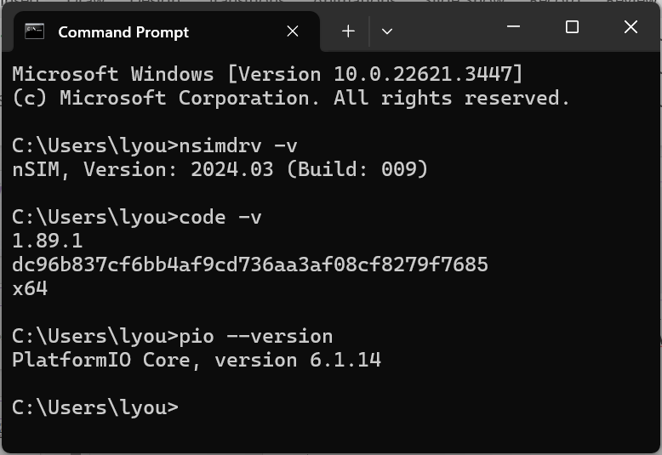
Perquisite
Follow official doc to install MetaWare nSIM + VS Code + PlatformIO
WIN CMD console to double check the success of these installations.
nsimdrv –v ## nSIM’s version
code –v ## VS Code version
pio –version ## platformIO version

Slide 7
QuickStart for MetaWare Risc-V VSCode based IDE
Introduction
Perquisite
Installation of nSIM
Installation of VS Code
Installation of PlatformIO core
Installation of this extension --- platformio-metaware-riscv
Installation of toolchain
Installation of builder and uploader
Building and Running HelloWorld project
Building HelloWorld project
Running HelloWorld project

Slide 8
Installation of the IDE Extension
The codebase of the IDE extension
https://github.com/foss-for-synopsys-dwc-arc-processors/platformio-metaware-riscv
git clone and cd into HelloWorld project
git lfs -b toolchain clone https://github.com/foss-for-synopsys-dwc-arc-processors/platformio-metaware-riscv.git
cd C:\Synopsys\Codebase\Workspace\platformio-metaware-riscv\examples/native-helloworld
Installation of toolchain
pio pkg install --tool toolchain-gccmetaware=file://C:/Synopsys/Codebase/Workspace/platformio-metaware-riscv/toolchain-gccmetaware.zip
Installation of builder and uploader
pio pkg install --platform metaware_riscv=https://github.com/foss-for-synopsys-dwc-arc-processors/platformio-metaware-riscv.git#main

Slide 9
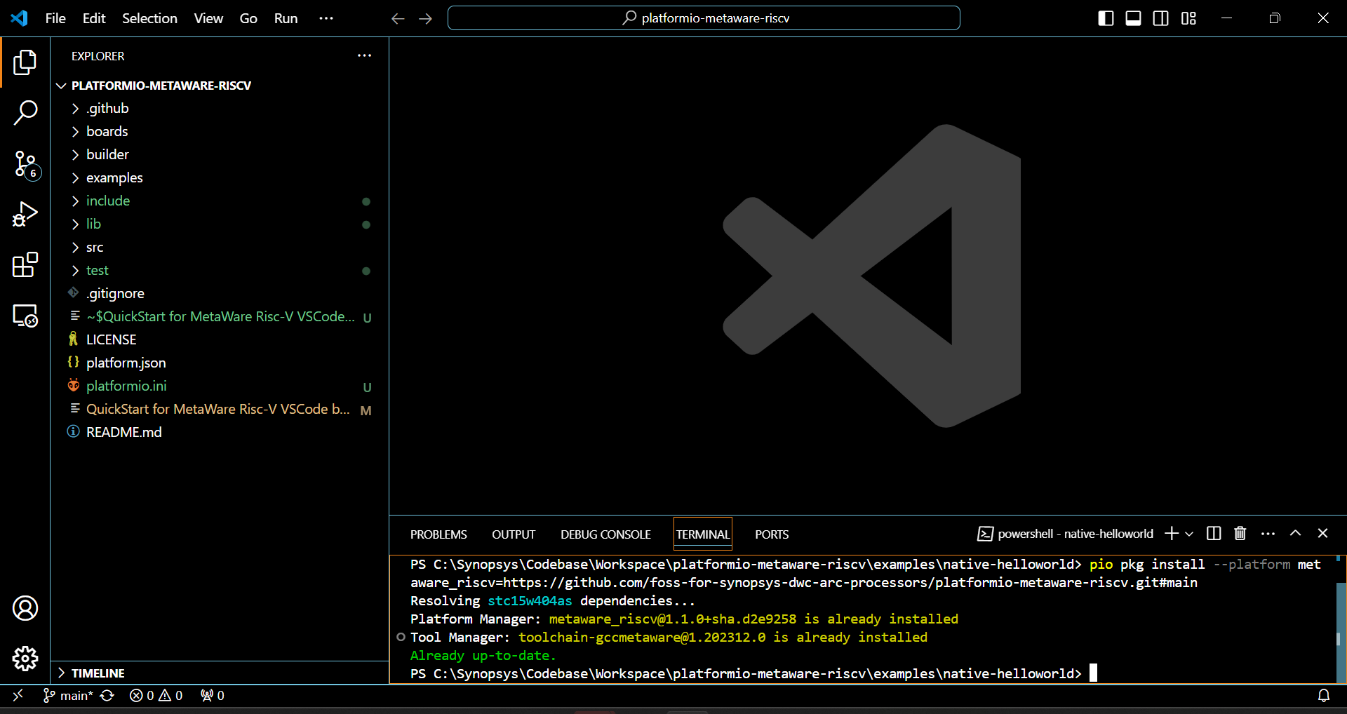
Installation of the IDE Extension (cont.)

Slide 10
QuickStart for MetaWare Risc-V VSCode based IDE
Introduction
Perquisite
Installation of nSIM
Installation of VS Code
Installation of PlatformIO core
Installation of this extension --- platformio-metaware-riscv
Installation of toolchain
Installation of builder and uploader
Building and Running HelloWorld project
Building HelloWorld project
Running HelloWorld project

Slide 11
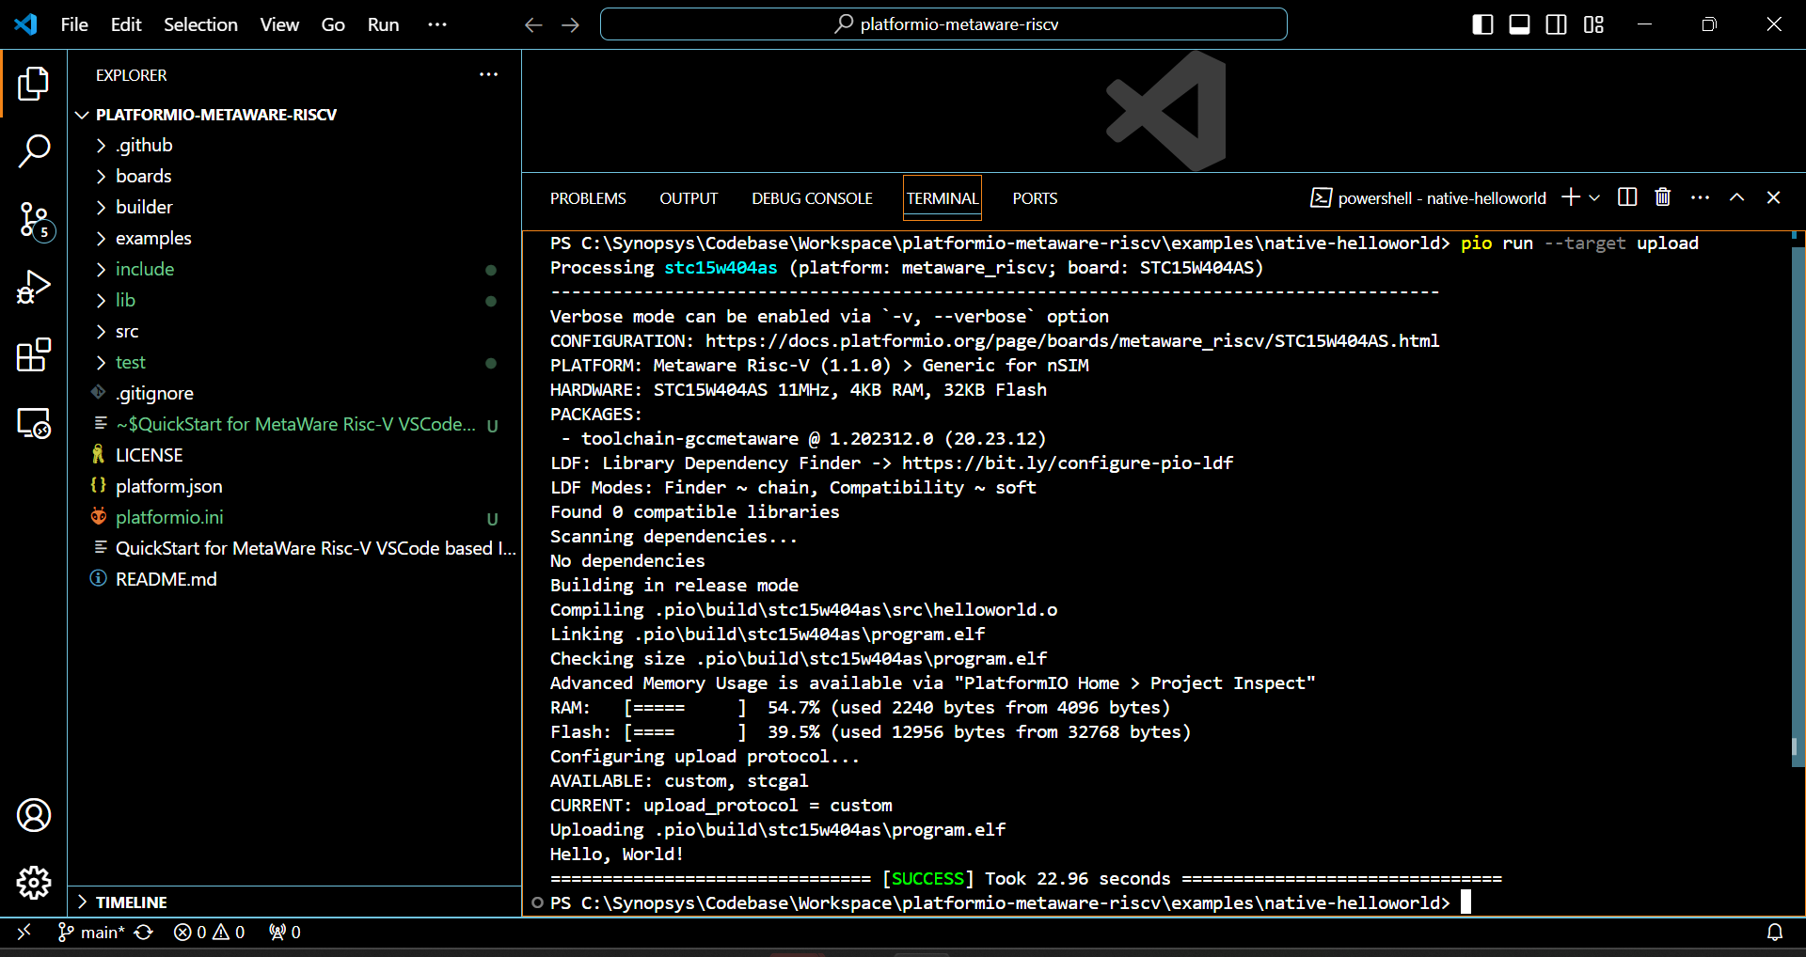
Building and Running HelloWorld project
Command in the IDE Terminal
pio run –target upload

